Slide 1
Take a Tour with Euler
Elementary Graph Theory –
Euler Circuits and Hamiltonian Circuits
Amro Mosaad – Middlesex County Academy

Slide 2
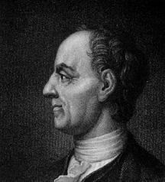
Leonhard Euler (1707-1783)
Swiss – also worked in Russia and Germany
Considered one of greatest and most prolific mathematicians ever; contributed greatly to
Number Theory
Calculus
Geometry
Trigonometry
Algebra
Father of Graph Theory

Slide 3
Named after Leonhard Euler
Euler's number (e)
Euler's formula
Euler's identity
Euler's theorem
Euler numbers
Euler approximations
Euler-Mascheroni constant
Euler path
Euler circuit

Slide 4
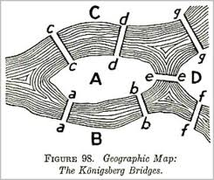
Euler's Bridges of Konigsberg Problem

Slide 5
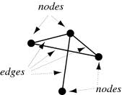
Basic Graph Theory
Vertex (or node)
- represented by a dot
Edge
- segment connecting two vertices

Slide 6
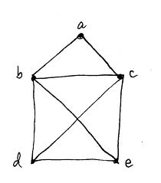
An Euler Circuit
A path that
(a) visits each edge exactly once, and
(b) starts and ends at the same vertex
Find an Euler circuit for the graph to the right

Slide 7

Bridges of Konigsberg Problem
The key is to represent the map as a graph with vertices and edges -
each land mass is a vertex, and
each bridge is an edge

Slide 8
Euler Circuits
A graph has an Euler circuit if and only if all vertices have an even degree.
A graph has an Euler path if there are no more than two vertices of odd degree.

Slide 10
Hamiltonian Circuits

Slide 15
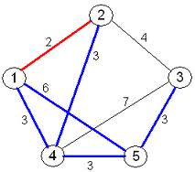
Solve this TSP

Slide 16
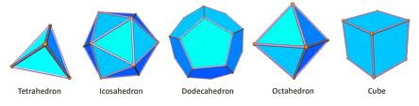

Platonic Solids

Slide 17

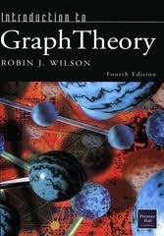
Further Study
Graph theory
Discrete
mathematics

